Slide 1


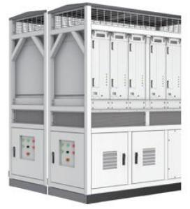


PCS canbinet Specification
No | Performance index | Parameter
1 | Operating Voltage Range | 1150-1500Vdc
2 | Operating Current Range | ≤2450A
3 | Rated AC Power | 2500kW
4 | Rated Operating Voltage | 400V/800Vac
5 | Rated Frequency | 50/60Hz
6 | Power Factor Adjustable Range | -1～+1
7 | Protection level | IP55
8 | Dimension(W*H*D) | 1900×2250×1700mm
9 | Weight | 2.4T
l With 24 hours insulation test to ensure system safety.
l Supports smooth switching and "black start" between on & off-grid
l Supports IEC 61850 protocol
l Supports VSG, PQ, VF, etc., with the functions of high & low voltage ride-through, frequency ride-through.
l Supports intelligent wave recording and local touch screen monitoring for locating events and faults instantly.
l Supports parallel connection of multiple products, convenient for capacity expansion, with battery charging and discharging management function, suitable for a variety of batteries.
Please note: All details of the project are subject to contract award.

