Slide 1
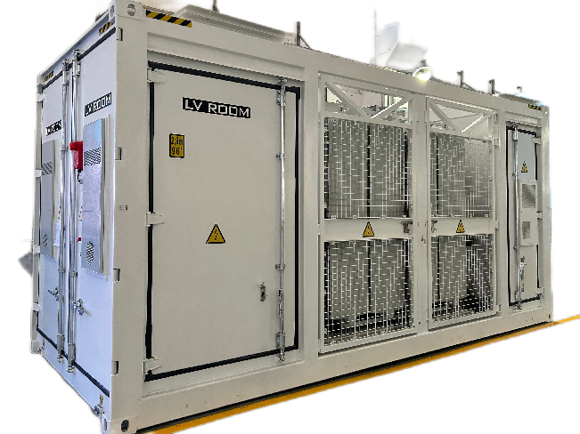
PCS Skid Specification
No. | Performance index | Parameter
PCS
1 | Operating Voltage Range | 1000-1500Vdc
2 | Operating Current Range | ≤2806
3 | Rated AC Power | 1250/2500/5000kW
4 | Rated Operating Voltage | 690Vac
5 | Rated Frequency | 50/60Hz
6 | Power Factor Adjustable Range | -1～+1
7 | Protection level | IP55
8 | Switching mode | Breaker
Transformer
1 | Type | Oil-type
2 | Rate Capacity | 2500kVA
3 | Voltage Ratio | 0.69kV up to 10//20/35kV
PCS Skid (With RMU)
1 | Dimension(W*H*D) | 6058*2896*2438mm
2 | Weight | 25T
With 24 hours insulation test to ensure system safety.
Supports smooth switching and "black start" between on & off-grid
Supports IEC 61850 protocol
Supports VSG, PQ, VF, etc., with the functions of high & low voltage ride-through, frequency ride-through.
Supports intelligent wave recording and local touch screen monitoring for locating events and faults instantly.
Supports parallel connection of multiple products, convenient for capacity expansion, with battery charging and discharging management function, suitable for a variety of batteries.
Please note: All details of the project are subject to contract award.

